Slide 1
Cincinnati Youth Collaborative
and
University of Cincinnati
Blue Ash College
Mentor Training
Dr. Greg Metz – Assistant Dean of Academic Affairs at UC Blue Ash
Cheri Jordan – CYC Senior College & Career Mentor Coordinator
Michelle Shade – UCBA CYC Mentor Program Coordinator
Notes:
1; Opening Slide

Slide 2

Training Objectives
You will:
  Discuss the WHY of College Mentoring
  Learn about CYC and get to know your team!
  What is College Mentoring?
  College Mentoring possibilities – Discuss strategies to optimize possibilities and address challenges.
  Know resources that encourage student & Mentoring success.
  Learn about MentorcliQ, our online Mentoring platform.
Please ASK lots of questions!
Notes:
2; Michelle

Slide 3
Getting To Know Each Other
Pair Up!
Share a fun fact with each other.
Why do you think College Mentoring matters?
Why do you want to Mentor?
Discuss a Mentor you have had – formal or informal – and her/his roles, methods and impact in your life.
What roles can a Mentor play & what role boundaries might a Mentor be mindful of?
If you have previously Mentored –
share one positive experience
and one not-so-good experience.
Notes:
5; Michelle

Slide 4

A Mentor is a…
Friend
Role model
Confidante
Advocate
Supporter
Connector
Motivator
Listener
Advisor
Coach
Image of Mentor and Mentee spending time together
A Mentor is not a Parent/Guardian, Social Worker, Disciplinarian, ATM, Therapist, or Critic
Notes:
1; Michelle. A friend. You are building a relationship just like in any friendship. You don’t want to push too hard too fast. What are things a Mentor is NOT? A Mentor is not a Parent/Guardian, Social Worker, Disciplinarian, ATM, Therapist, or Critic

Slide 5

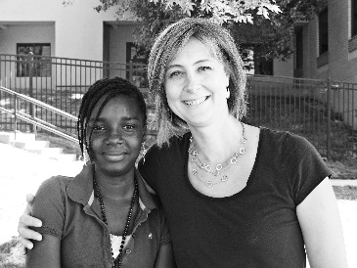


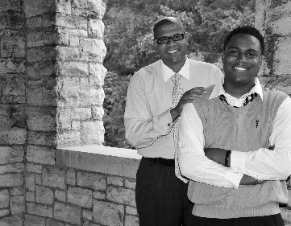
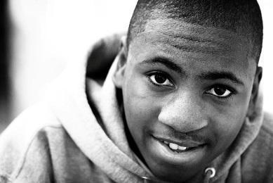

CINCINNATI YOUTH COLLABORATIVE
About CYC Vision & Programs
All youth will achieve their full potential.
Images of Mentees served by CYC
Notes:
3; Cheri

Slide 6

About Our Students:
UCBA Academic Achievement Scholars
3.2-3.51 High School GPA
ACT below 25
Not served by UCBA Honors Program
$500 per semester for Year #1
Spring semester award contingent on 3.0 GPA Fall 2019 & College Mentoring Participation
Stretch goals – access preferred program, new connections and learning opportunities
Notes:
3; Greg

Slide 7
Activity: Relationship Builder
Pair Up!
Notes:
4; Michelle

Slide 8
Relationship Builder: M&M Game
Each person gets a small pack of M&Ms. Each color has a specific question attached to it. As you eat the M&Ms together, you have to answer the question that pertains to the color you are consuming.
RED – Something you did this summer.
YELLOW – A favorite book or movie.
BLUE – “Wild card” – Share anything!
BROWN – A favorite food or cuisine.
GREEN – Something you are scared of.
ORANGE – Something you do well.
Notes:
4; Michelle

Slide 9
Activity: Goals of Mentoring
The goals of mentoring include establishing deep, meaningful, and impactful relationships and doing so in a timely way. This can be challenging – let’s discuss how we can proceed toward this goal.
Pair up in groups of 3-4
Develop a list of areas of conversation that Mentors and Mentees could engage in over time.
Discuss any ideas or strategies for
developing deep, meaningful,
impactful relationships.
Notes:
4; Greg

Slide 10
Discussion Areas :
The “Guide on the Ride” Approach
Well Being
Learning – Before, During, and After Class
Relationships and Connections
Notes:
7 min slides 10-13; Greg. Goals – encourage mentors to open up conversations in various areas – well-being, learning, relationship and more; encourage mentors to be the “guide on the ride” – that is sharing their own journeys, struggles, etc in these areas – past and present – sharing strategies they use and encouraging students to discover the strategies that work for them?

Slide 11
Well Being: Conversation Suggestions
How are you feeling physically (1-10)
How well and how much are you sleeping (1-10 / hours)
How would you rate eating habits (1-10)
How are things going financially (1-10)
How would you rate your stress levels (1-10)
What things – if any – are leading to stress?
What do you do to alleviate stress?
What do you do to alleviate stress?
What well-being goals do you have?
What’s one action you could install today
to enhance your well being?
Notes:
Greg

Slide 12
Learning: Conversation Suggestions
Do you have all of your books?
Do you have a laptop?
How many hours outside of class per week do you plan to study?
How do you use those hours?
What are your strategies to support undistracted study time?
What are your daily time management strategies?
What are your goals for further enhancing your learning muscles?
What’s one action you could install today
to enhance your learning muscles?
Notes:
Greg

Slide 13
Relationships and Connections: Conversation Suggestions
How well do you keep up with family and friends while at college (1-10)?
Have you made some new friends yet at college?
Have you met with a professor outside of class?
When do you plan to meet with your academic advisor?
What goals do you have for further enhancing your connections – personal and at UCBA?
What’s one action you could take to enhance connections?
Notes:
Greg

Slide 14
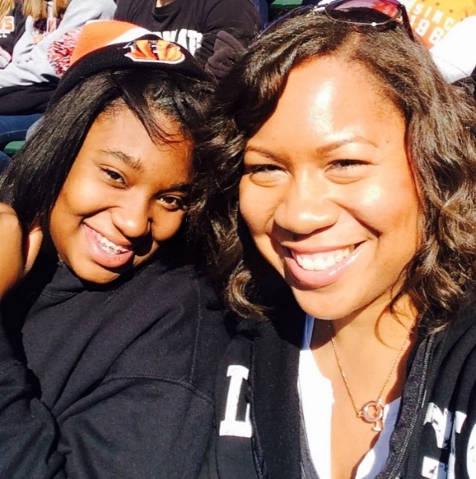
Mentoring Goals:
Mentor & Mentee
Mentee is exposed to pro-social behavior
Mentee is supported in their academics
Mentee is exposed to the world of work for career exploration and workforce readiness
  UCBA &UC workforce readiness
“I am learning to appreciate every victory, large and small, and I am realizing the profound effect that my actions can have. I am making a difference, and that makes all the difference to me.” – Rhonda Post, CYC Mentor
Image of Mentor and Mentee spending time together
Notes:
3; Greg. Guide mentee to make rational decisions at an irrational time. Connect learning with earning. Engage them to life, future forward.

Slide 15
Activity: Maximizing Opportunities and Addressing Challenges
Discus previous Mentoring relationships in which you have been involved – formal or informal. What went well and why? What went “south” and why? What did you learn that could be applied in future Mentoring relationships?
Pair Up
First person – Talk
Second person – Listen, Reflect, and Discuss
Switch roles after 3 minutes
Notes:
7; Greg

Slide 16
Activity: Cross Cultural Communication
Everyone will receive one slip of paper, labeled A, B, C, or D
Please silently read the instructions given to you on your slip of paper, but do not share what is written on the slip with anyone.
Each member of Group A will partner with a member of Group B; Group C members will partner with Group D members.
You and your partner will have 7-10 minutes to learn more about each other, based on what is on your slip of paper.
Notes:
8; Cheri

Slide 17
Activity: Cross Cultural Communication
For participants to recognize that people communicate differently, based mostly from cultural context.
Considerations within Mentoring
  UCBA/CYC expectations of service
  Mentor’s expectations of relationship
  Mentee’s expectations of relationship
What gained from this activity can be translated into specific enhancements or changes in your work with others?
Notes:
5; Cheri

Slide 18
Two monthly engagements
(face-to-face, phone, text, email or video chat)
For one academic year
(September 2019-April 2020)
Completion of Monthly Surveys
(3 per semester)
CYC College Mentoring Expectations
Notes:
3; Michelle. These expectations are the baseline helped used to evaluate participation from both the Mentor and Mentee.

Slide 19
UCBA & CYC Training Documents
We hope you use the training documents – and your on-campus Mentor Coordinator – as a reference for any questions you have about procedures, expectations, or mentor/mentee partnerships this year.
Welcome, From Your Mentoring Team
CYC Mentoring Expectations
Calendar
Relationship Builders
Notes:
3; Michelle

Slide 20
Mentoring Communication
To help support your Mentoring relationship, you will receive the following communications from your Mentor Coordinator -
  Bi-Weekly Curriculum Communication
  Monthly Check-In Surveys (3 per semester)
  General announcements
All scheduled communications can be found on the calendar
AmericaMentors will be the sender unless coordinator is communicating from their UCBA or CYC email
We expect the surveys to be completed in the time frame given to you by your Mentor Coordinator!
Notes:
3; Michelle

Slide 21
UCBA & CYC Website
https://ucblueash.edu/students/services/mentoring/cyc.html
Program Overview
Training Documents
Mentor Resources
  Curriculum Communication/Resources
  Mentoring Relationship Agreement, Mid-Cycle Check-In, Closure Agreement
UCBA College Resources
Notes:
3; Michelle

Slide 22
Important UCBA Resources
UC Blue Ash Web Site
  KEYWORD – MENTORING PROGRAMS
Academic Advising
Career Center
Counseling
FYE – First Year Experience Courses
Accessibility Resources (Disability Services)
Tutoring & Academic Coaching
One Stop
Student Life
Notes:
3; Michelle

Slide 23
Keys to College Success Fund
Sponsored through a generous grant of the Key Bank Foundation, to assist students who are participating in CYC College Mentoring and find themselves in need of non-recurring emergency financial assistance associated with maintaining college attendance.
Build personal relationship with your mentee
Alert College Mentor Coordinator if you feel your
mentee has a non-recurring financial need
College Mentor Coordinator will
contact student to assess need
and follow procedure
Notes:
3; Michelle

Slide 24
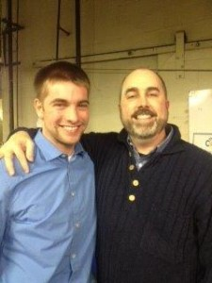
Effective Mentoring
Tips and Suggestions
Initiate and facilitate the relationship
Schedule a communication routine – Consistency is key!
Keep relationship building front and center!
Communicate and check in – early and often
Be curious - listen well and learn
Be patient and resilient
Complete agreement, goals, and progress checks
Utilize and connect your Mentee to resources – Mentor Coordinator, Curriculum, and website
Be available, be consistent, and set an example
Provide your insight about life!
Image of Mentor and Mentee spending time together
Notes:
5; Greg

Slide 25
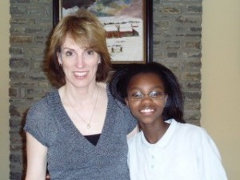
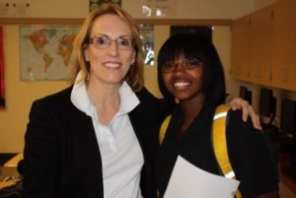

Benefits of Mentoring
Allows Mentor to…
Develop a supportive relationship
Assist with problem solving
Provide professional development and support for academic achievement
Provide opportunities with other cultures to help develop a greater appreciation for diversity that will ready the mentee for the workforce
Reflect on their own practice for self-growth
Images of Mentors and Mentees spending time together
Notes:
3; Cheri

Slide 26
Important Dates
Mentoring Match – Wednesday, August 28th
Mentor matching will happen electronically! Expect an Email from AmericaMentors with your Mentee match, along with their contact information. If you need additional information or have any questions, please reach out to your Mentor Coordinator.
Kickoff Event – Wednesday, September 4th, 4:45pm-6:15pm
The Kickoff is your initial meeting with your Mentee! We will have food and beverages, along with a
“Relationship Builder” activity, the chance
to set your goals for the year, and
complete your Mentoring agreement.
PLEASE CONFIRM ATTENDANCE WITH MENTEE!
Notes:
3; Michelle

Slide 27

Questions
Image of cartoon person thinking of a question
Michelle Shade – UCBA College Mentor Coordinator
Email: ucbacyccoach@ucmail.uc.edu
Notes:
3; Michelle

